Slide 1

The National University of Computer and Emerging Sciences
Programming Fundamentals
CS 1002 Programming Fundamentals
Dr. Akhtar Jamil
Department of Computer Science

Slide 2
Goals
Review of Previous Lecture
Introduction to Pseudocode
Flowcharts
First C++

Slide 3
Review of Previous Lecture

Slide 4
What is a Computer?
A computer is a electronic device that works semi-automatically to process input data according to the stored set of instructions and produces output or resultant data.
Instructions
A Computer System
Results
Data

Slide 5
Components of a Computer System
Peripheral Devices / Connected devices
Keyboard
Mouse
Display
CD Rom
Hard Disk
Computer
Main Memory
CPU
A Typical
Von-Nueman Machine
Arithmetic and Logic Unit
Control Unit

Slide 6
Computer Instructions and Programs
Instruction: A computer instruction is a command or directive given to a computer to perform specific task.
Examples: Add 2 and 5, Print “Hello World”
Program: A program is sequence of instructions written in programming language that directs a computer to solve a problem
Examples: Draw a square, etc.

Slide 7
Computer Instructions and Programs
Program: “Draw a square”
1 – Draw a vertical line of length n inches
2 – Draw a horizontal line of n inches
3– Draw a vertical line of length n inches
4 – Draw a horizontal line of n inches

Slide 8
Computer Software System
Application Programs
(.cpp, .c, .java,)
Compilers / Libraries
(C++, C, Java)
Operating Systems
(Windows, Linux, MAC, Solaris)
Computer Hardware

Slide 9
Programming Languages
Classification of programming languages:
Machine language
Low-level languages
High-level languages

Slide 10
Programming Paradigms
Programming paradigm is the fundamental style of computer programming:
Imperative
Functional
Logical
Object Oriented

Slide 11
Problem Solving Steps
Understand the problem
Plan the logic
Code the program
Test the program
Deploy the program into production

Slide 12
Today’s Lecture

Slide 13
Introduction to Pseudocode
One of the popular representation based on natural language
Widely used
Easy to read and write
Allow the programmer to concentrate on the logic of the problem
Structured in English language (Syntax/grammar)

Slide 14
What is Pseudocode (continued...)
English like statements
Each instruction is written on a separate line
Keywords and indentation are used to signify particular control structures.
Written from top to bottom, with only one entry and one exit
Groups of statements may be formed into modules

Slide 15
Some Basic Constructs
Print → Output is to be sent to the Printer
Write → Output is to be written to a file
Display → Output is to be written to the screen
Prompt → required before an input instruction Get, causes the message to be sent to the screen
Compute /Calculate → Calculation performed by computer
Calculation operations: +, -, *, /, ()

Slide 16
Some Basic Constructs
Set → Used to set inital value,
E.g., Set Marks to 0
= → Place values from right hand-side item to left hand side
E.g., Marks = 67
Save → Save the variable in file or disk
E.g., Save Marks

Slide 17
Example Pseudocode Program
A program is required to read three numbers, add them together and print their total.
Inputs | Processing | Output
Number1 Number2 Number3 |  | total

Slide 18
Solution Algorithm
Add_three_numbers
Set total to 0
Read number1
Read number2
Read number3
Total = number1 + number2 + number3
Print total
END

Slide 19
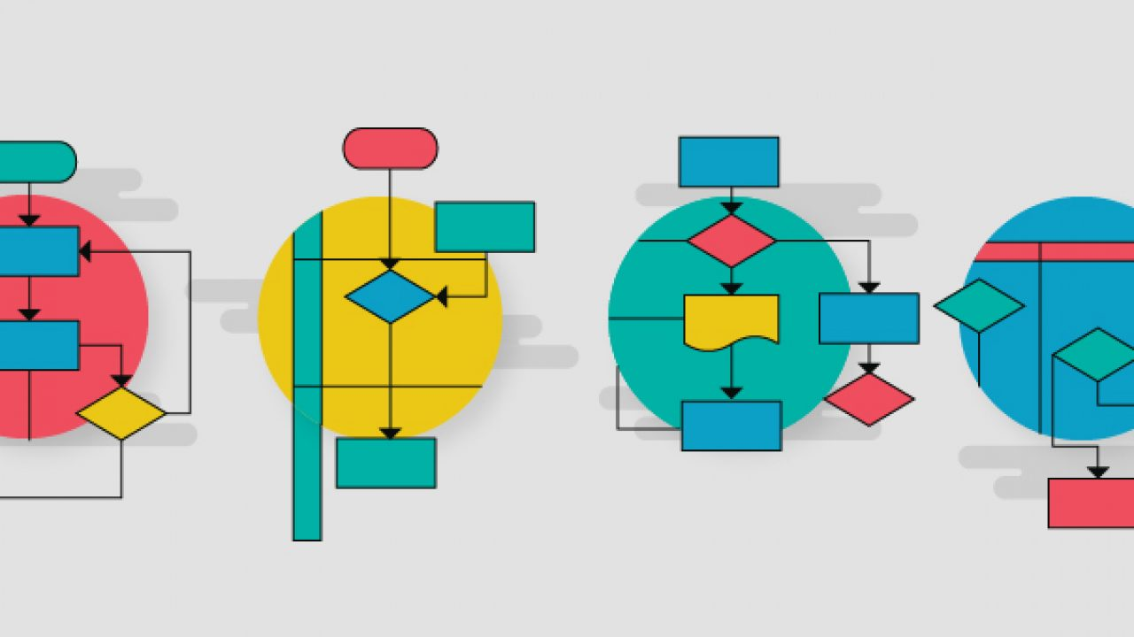
Program Logic: Flowcharts
“A graphic representation of a sequence of operations to represent a computer program”
Shows steps of the solution
Shows individual steps and their interconnections
https://d3n817fwly711g.cloudfront.net/uploads/2017/07/flowchart-feature-image-01-1280x720.jpg

Slide 20
Basic Flowchart Symbols
Name | Symbol | Description
Oval |  | Beginning or End of the Program
Parallelogram |  | Input / Output Operations
Rectangle |  | Processing for example, Addition, Multiplication, Division, etc.
Diamond |  | Denotes a Decision (or branching) for example IF-Then-Else
Arrow |  | Denotes the Direction of logic flow

Slide 21
Example 1
START
Step 1: Input M1,M2,M3,M4
Step 2: GRADE = (M1+M2+M3+M4)/4
Step 3: if (GRADE < 50) then
Print “FAIL”
else
Print “PASS”
endif
Input
M1,M2,M3,M4
GRADE←(M1+M2+M3+M4)/4
IS
GRADE<50
No
Yes
Print
“PASS”
Print
“FAIL”
STOP

Slide 22
Example 2
Write an algorithm and draw a flowchart to convert the length in feet to centimeter.

Slide 23
Example 2
Algorithm
Step 1: Read Lft
Step 2: Lcm = Lft x 30
Step 3: Print Lcm
Flowchart
START
Read Lft
Lcm = Lft x 30
Print LCM
STOP

Slide 24
Example 3
Write an algorithm and draw a flowchart that will read the Length and Width of a rectangle and calculate its area.

Slide 25
Example 3
START
Algorithm
Step 1: Read W,L
Step 2: Area = L x W
Step 3: Print A
Read
W, L
Area ← L x W
Print
Area
STOP

Slide 26
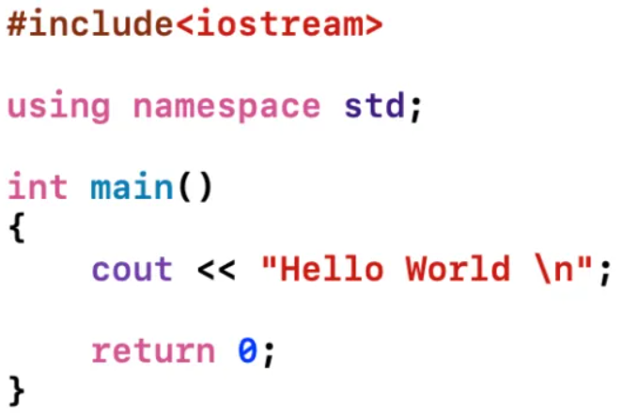
First C++ Program
Preprocessor Directive
Standard Namespace
main function
Print message on screen
end main function

Slide 27
Preprocessor Directives
#include<iostream>
# is a preprocessor directive
The preprocessor runs before the actual compiler and prepares your program for compilation.
Lines starting with # are directives to preprocessor to perform certain tasks, e.g., “include” command instructs the preprocessor to add the iostream library in this program

Slide 28
main( ) function
Every C++ program start executing from main ( )
A function is a construct that contains/encapsulates statements in a block.
Block starts from “{“ and ends with “}” brace
Every statement in the block must end with a semicolon ( ; )
Examples…

Slide 29
Example Program 1
#include <iostream>
using namespace std;
int main()
{
int num1 = 5, num2, sum;
num2 = 12;
sum = num1 + num2;
cout << "The sum is " << sum;
return 0;
}

Slide 30
Example Program 2
#include <iostream>
using namespace std;
int main()
{
int num1 = 5, num2, sum;
cout << “Enter second number: “;
cin >> num2
sum = num1 + num2;
cout << “The sum is “ << sum;
return 0;
}

Slide 31
Practice Tasks
How to find the largest among three numbers?
Check a Number is Positive or Negative?

Slide 32
References
Credit goes to Dr. Muhammad Aleem for preparation of slides

Slide 33
Thank You ☺

